Slide 1

Exploratory Data analysis on Olympic
By:- Rituraj Sharma

Slide 2
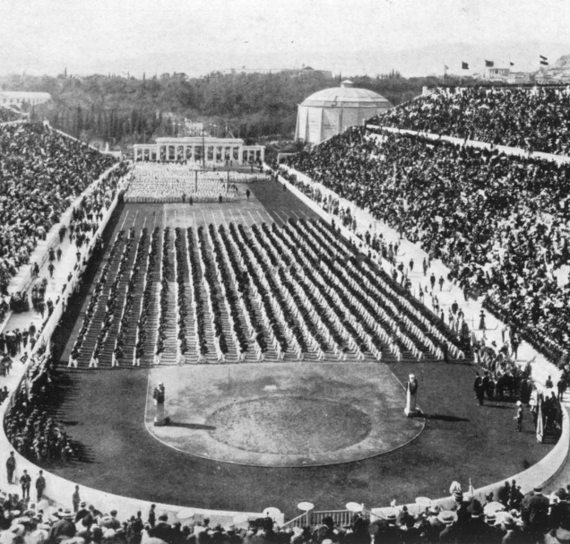

Overview about the dataset
The "120 Years of Olympic History Athletes and Results" dataset is a comprehensive collection of data on the modern Olympic Games, spanning from Athens 1896 to Rio 2016. It provides detailed information about athletes, events, and results for both the Summer and Winter Olympics. This dataset is a valuable resource for exploring the history of the Olympics, analyzing athlete performance, and understanding trends in Olympic participation..
Athens 1896

Slide 3

Queries
How does age affect medal wins for different genders?
Which countries have won the most medals overall?
How has the average age of athletes changed over the years?
What are the most popular sports in the Olympics based on the number of participants?
Which sports have the highest proportion of female athletes?
How does the height and weight of athletes vary across different sports?

Slide 4

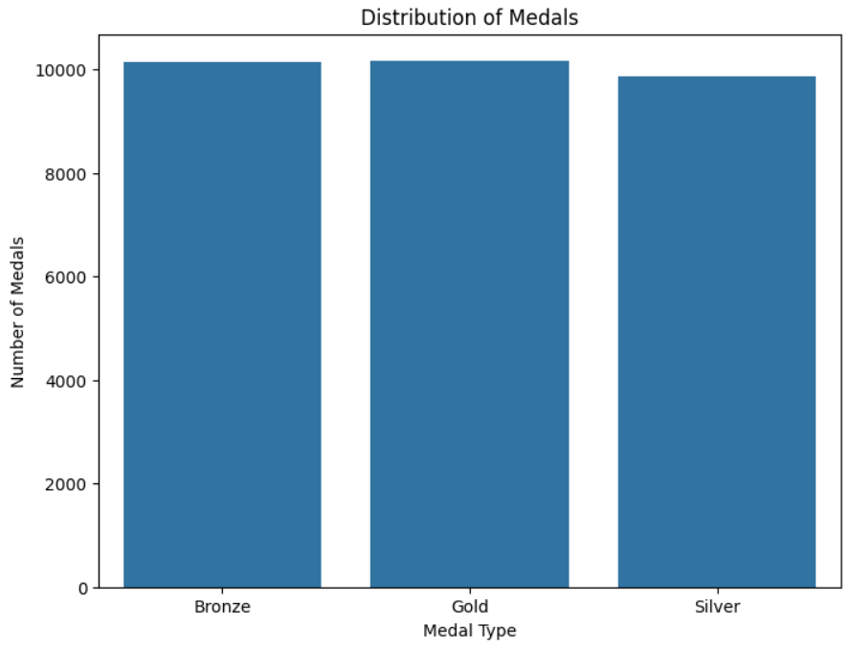

Q.1 How does age affect medal wins for different genders?
There are many age-related patterns in medal wins for male and female athletes. Generally, you'll likely find that athletes in their mid-20s to early 30s tend to win more medals. There may be slight variations between genders for certain sports.

Slide 5

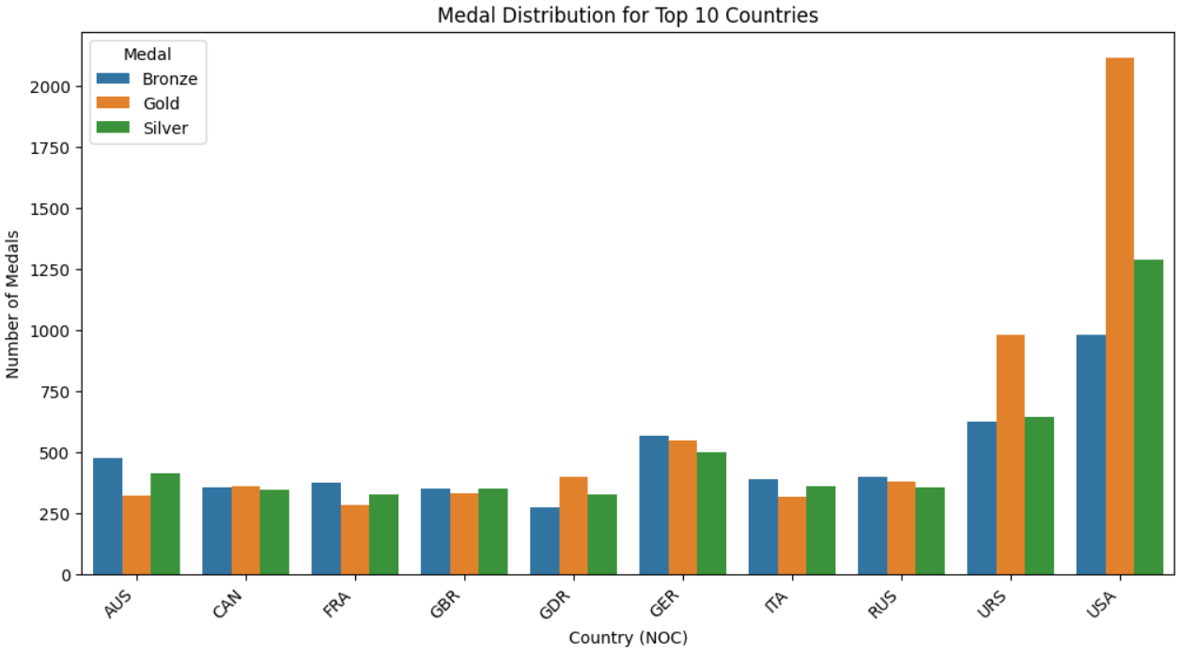
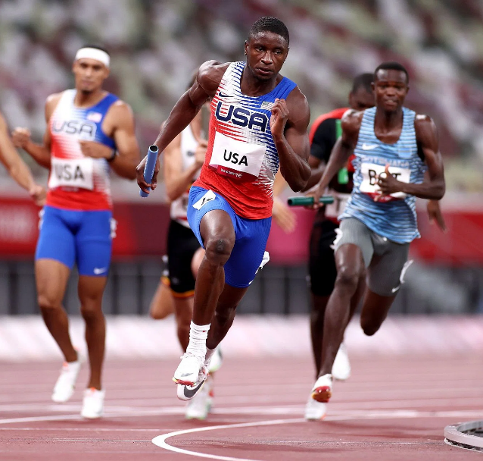
Q.2 Which countries have won the most medals overall?
The top countries with the most Olympic medals earned throughout history you'll likely find that the United States, Soviet Union (and Russia), and Germany are among the top contenders.

Slide 6

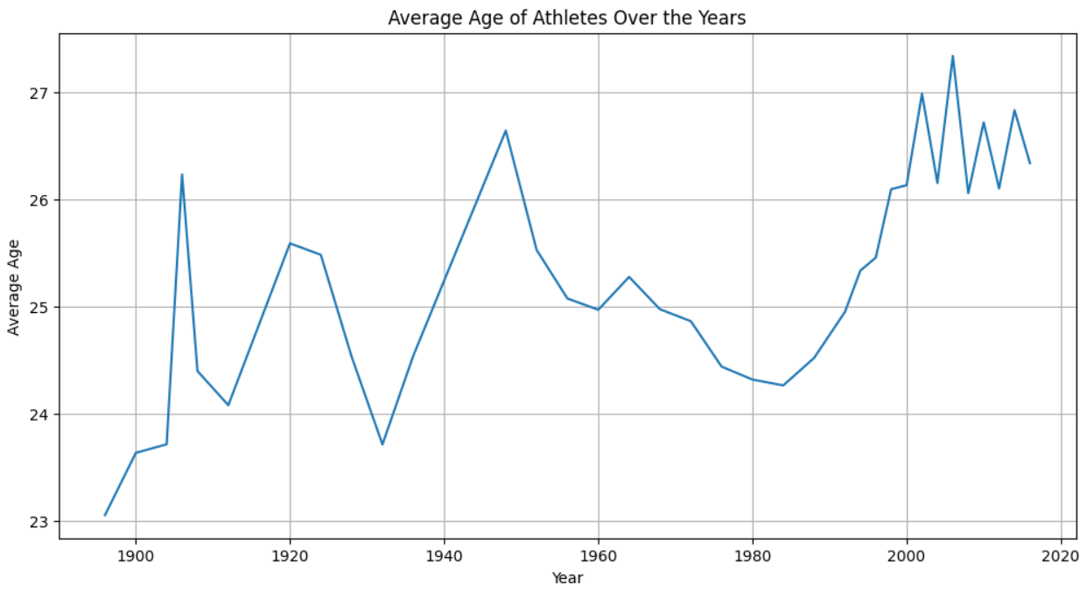
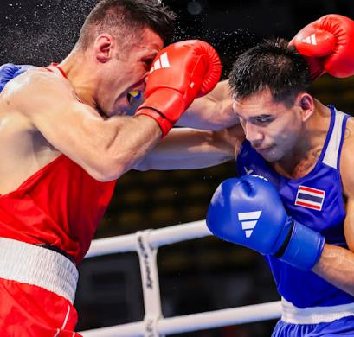
Q.3 How has the average age of athletes changed over the years?
The line plot will show the trend of average athlete age over the years. It is likely to show a gradual increase in average age, possibly due to factors like better training and sports science.

Slide 7
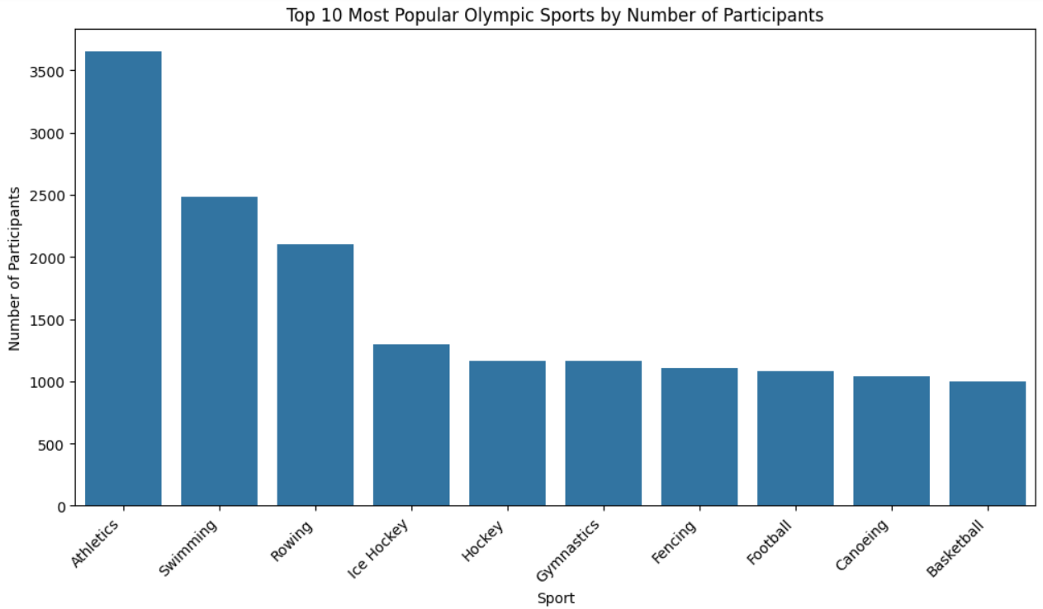



Q.4 What are the most popular sports in the Olympics based on the number of participants?
The most participants. Athletics, Gymnastics, and Swimming are generally among the most popular.

Slide 8
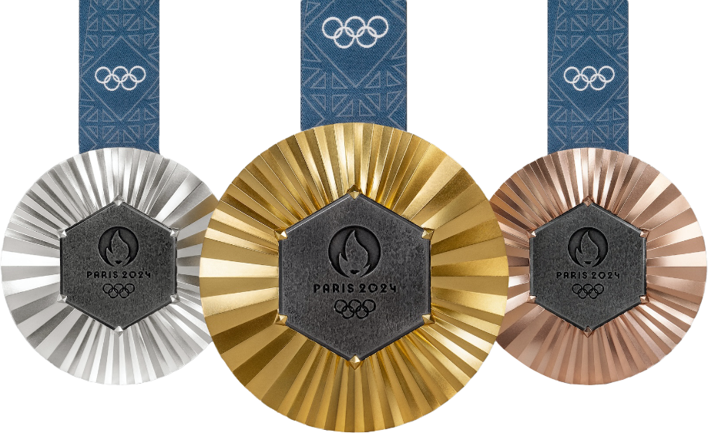
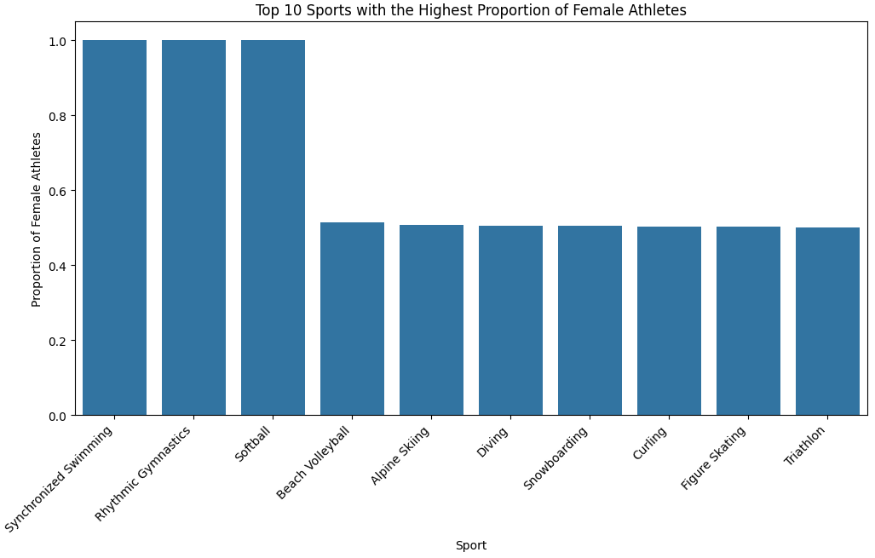
Q.5 Which sports have the highest proportion of female athletes?
The highest percentages of female athletes. You might see sports like Rhythmic Gymnastics, Synchronized Swimming, and Volleyball

Slide 9
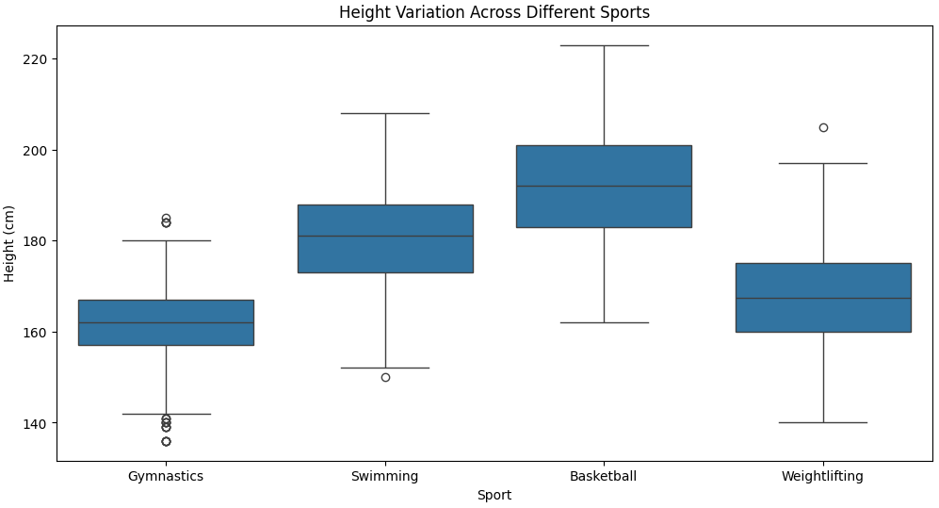
Q.4 What are the most popular sports in the Olympics based on the number of participants?
These box plots will visually illustrate the differences in height and weight distributions across the selected sports. Basketball players are likely to be taller and heavier, while gymnasts tend to be shorter and lighter.

Slide 10
Conclusion
United States Dominance: The United States has been the most dominant country in the Summer Olympics, consistently winning the highest number of medals overall. This success can be attributed to factors like a large and diverse athlete pool, strong infrastructure for sports development, and significant investments in training and technology.
Rise of Women in Olympics: There has been a significant increase in female participation in the Olympics over the years. This trend reflects the growing recognition and acceptance of women in sports, as well as efforts to promote gender equality in athletic opportunities.
Shifting Global Power: The Olympics have witnessed a shift in global power dynamics over time. The Soviet Union (and later Russia) emerged as a major force in the mid-20th century, while China has become increasingly prominent in recent decades. These changes reflect broader geopolitical shifts and economic development.
Impact of Hosting: Hosting the Olympics often provides a boost to a country's medal tally. This "home advantage" can be attributed to factors like increased funding, infrastructure improvements, and heightened public support for athletes.
Body Size and Sport: The physical characteristics of athletes vary significantly across different sports. For example, basketball players tend to be taller and heavier, while gymnasts are typically shorter and lighter. This reflects the specific demands and skills required for each sport.
Age and Performance: There is a correlation between age and athletic performance. While athletes of all ages participate in the Olympics, medal winners tend to be slightly older, indicating that experience and peak physical condition play a role in achieving success.
Popularity of Sports: Some sports, such as Athletics (Track and Field), Gymnastics, and Swimming, have consistently had high participation rates in the Olympics. This reflects their global appeal and accessibility.

Slide 11
THANK YOU

